Slide 1
Use of The ACS Exam Trimmer App
Questions or issues can be sent to David Schreurs at schreurd@uwm.edu

Slide 2
Table of Contents
Upload Data
National Item Statistics
Modeled Exam Norm
Observed Exam Norm
Comparison of Exam Norms
Comparison of Item Stats
Student Scores
Custom Item Weights
Export Results
Excel Results

Slide 3
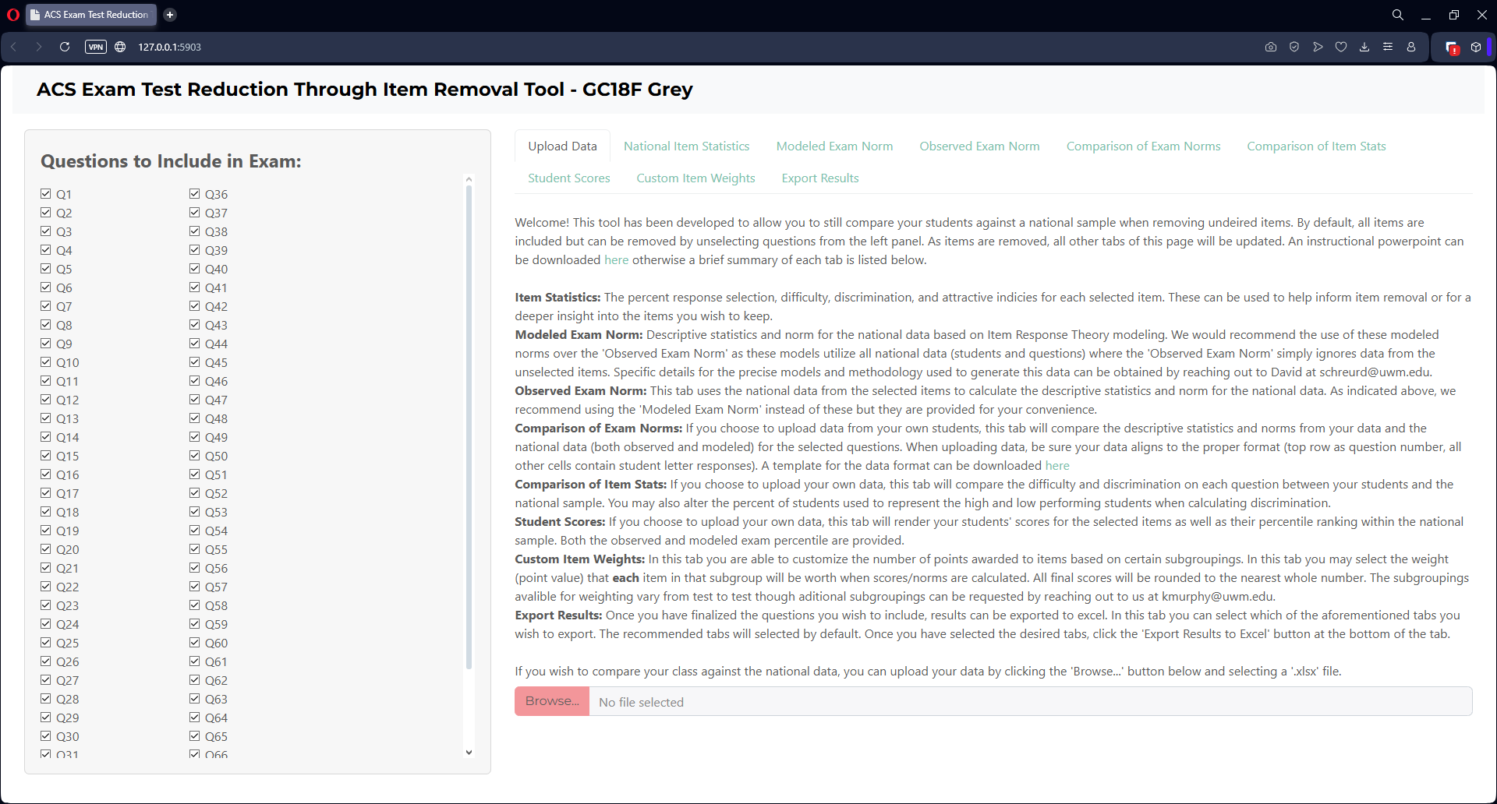
Upload Data
This tab provides you with a general overview of the webapp as well as the opportunity to upload data of your own. If you choose to upload your own data, simply click the red “Browse…” button at the bottom of the page

Slide 4
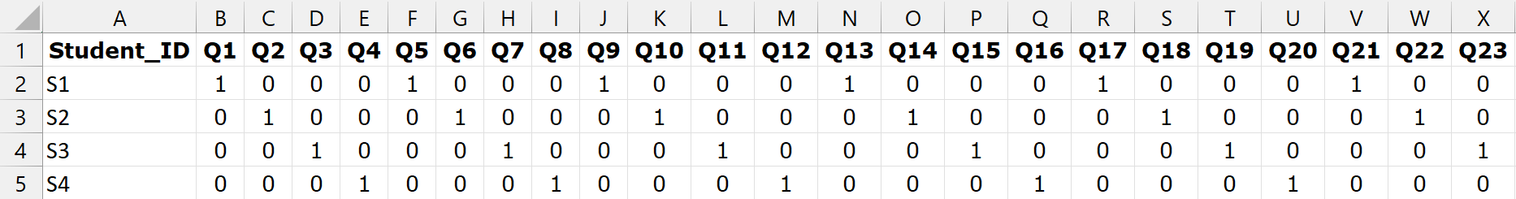
Upload Data
Download Data Template
If you opt to upload your own data, it must follow this format
  Rows of students; Columns of questions; Cells of dichotomous (0/1) responses
Furthermore…
  Row 1 should contain “Student_ID” and the question numbers preceded with the capital letter “Q”
  Column A should contain a student identifier. This can be any format (e.g., student ID number, student name, student numbering, etc.)

Slide 5
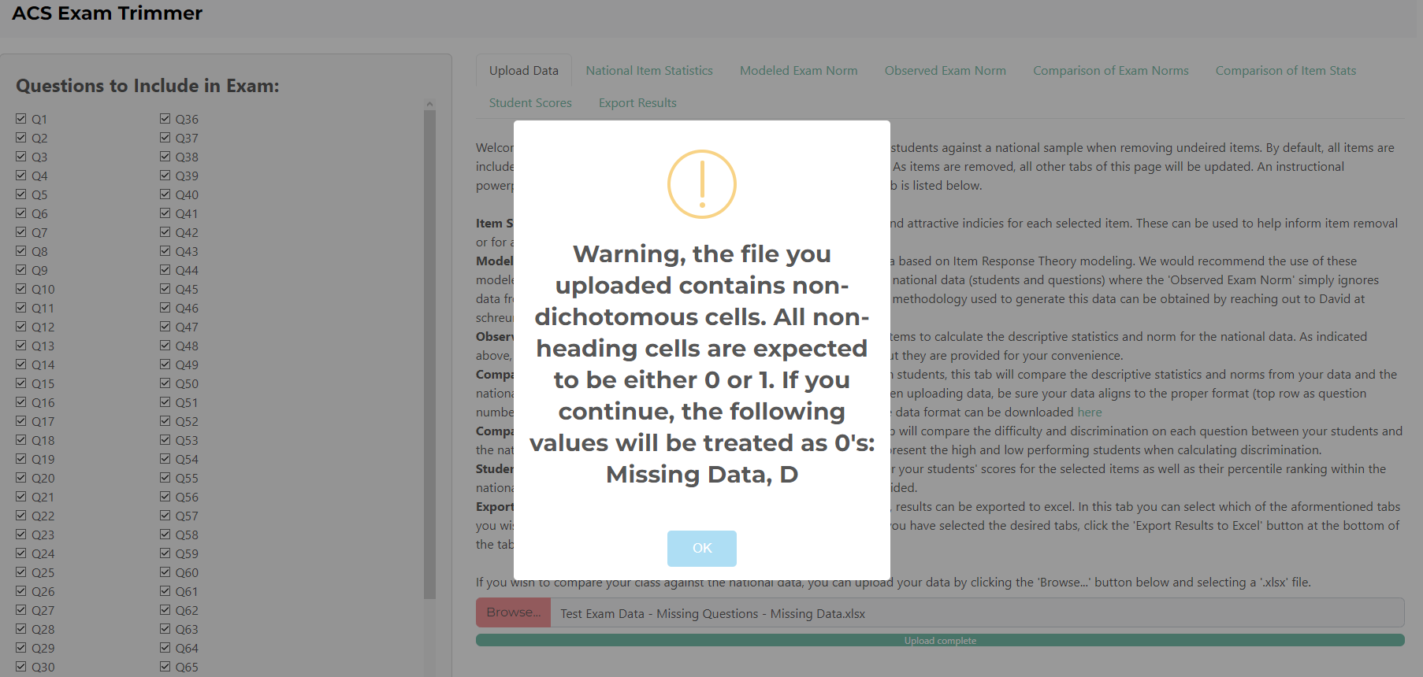
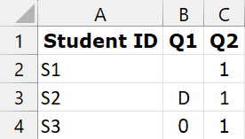
Upload Data
Download Data Template
If your uploaded data is not dichotomous, a popup will appear warning you what non-dichotomous values were detected and that if you precede, they will be treated as “0’s”
B2 is missing data
B3 is the letter “D”

Slide 6
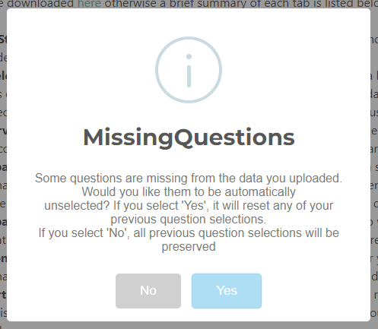
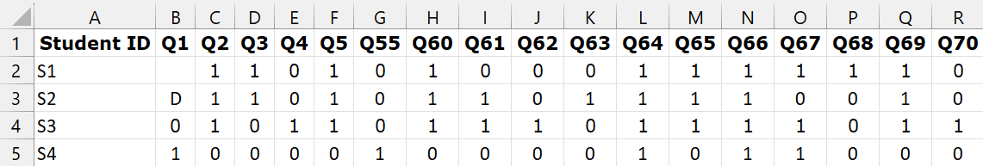
Upload Data
Download Data Template
If your uploaded data is missing questions, you will be given the option to treat the missing questions as 0’s, or to remove the missing questions from the national data
Data is missing many questions

Slide 7
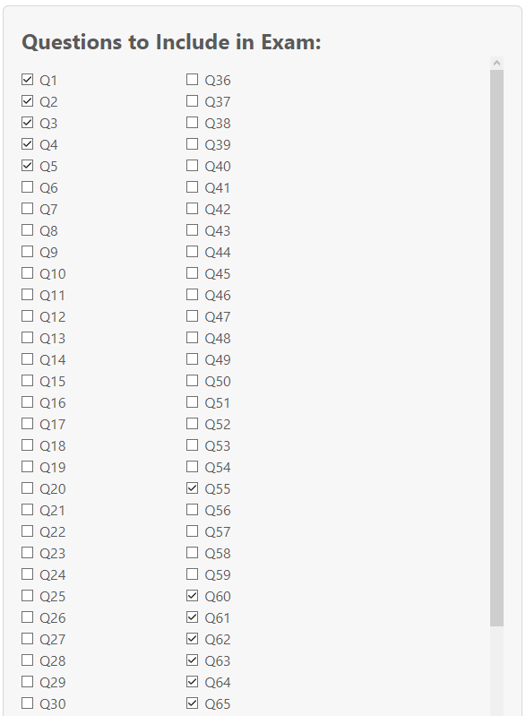
Upload Data
Download Data Template
If you select yes, the missing items will be automatically unselected
Data is missing many questions

Slide 8
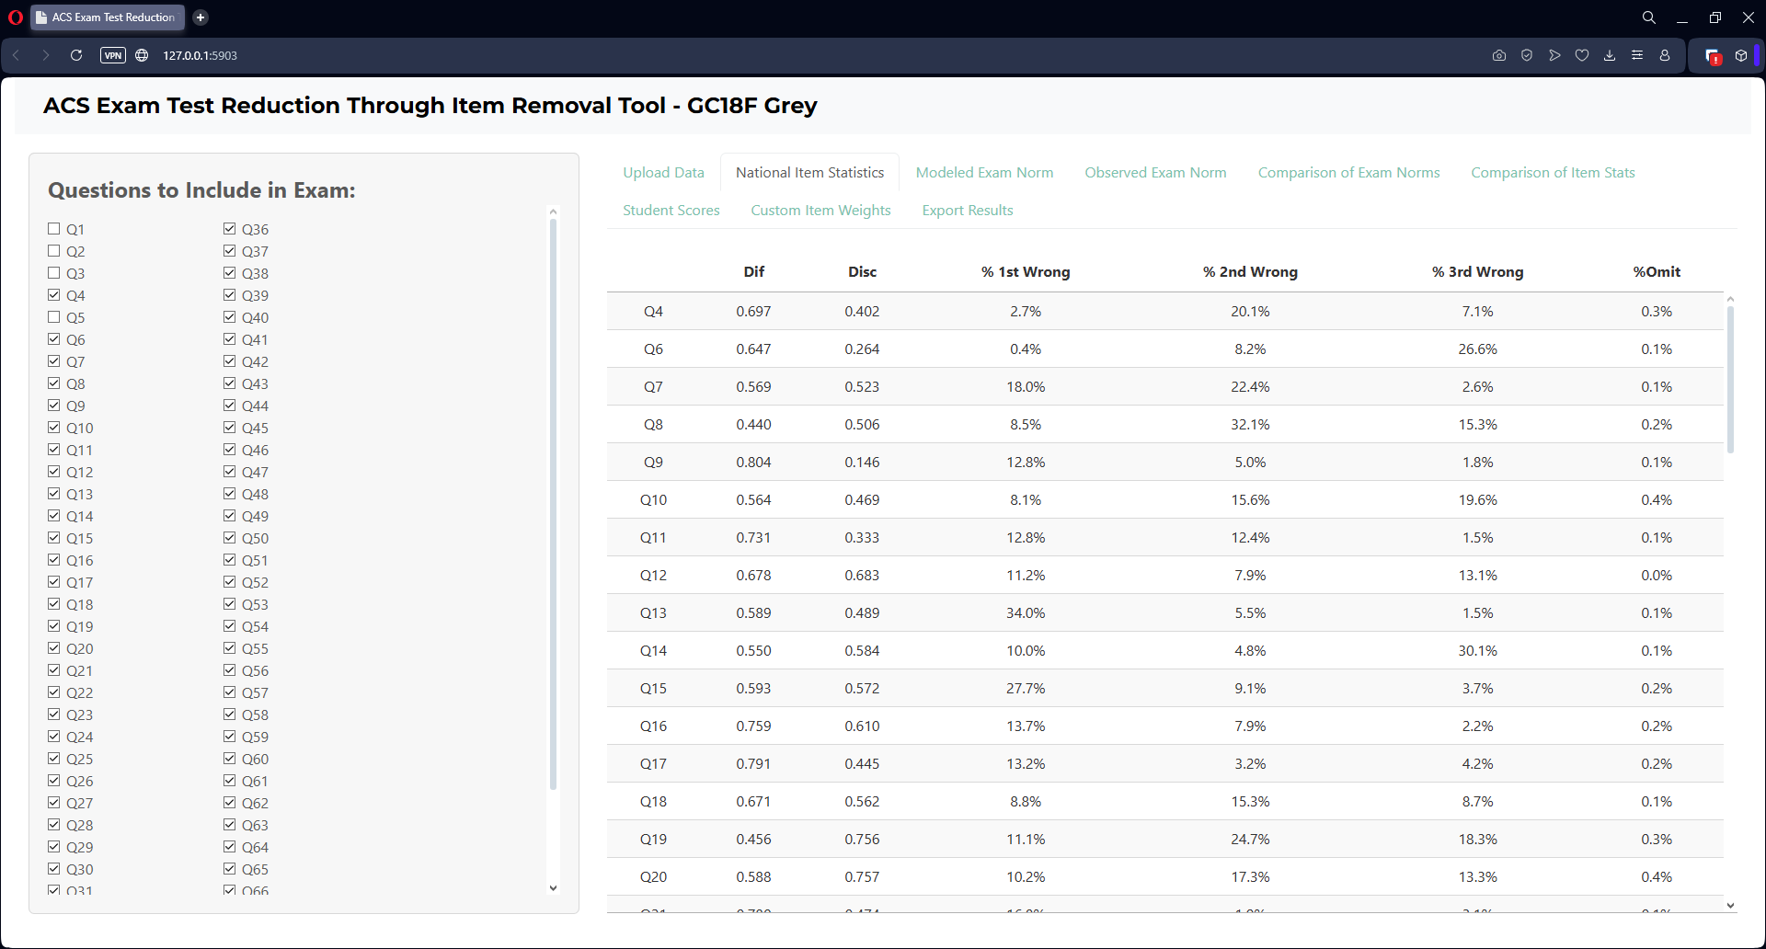
National Item Statistics
This tab will show the items statistics for the selected questions

Slide 9
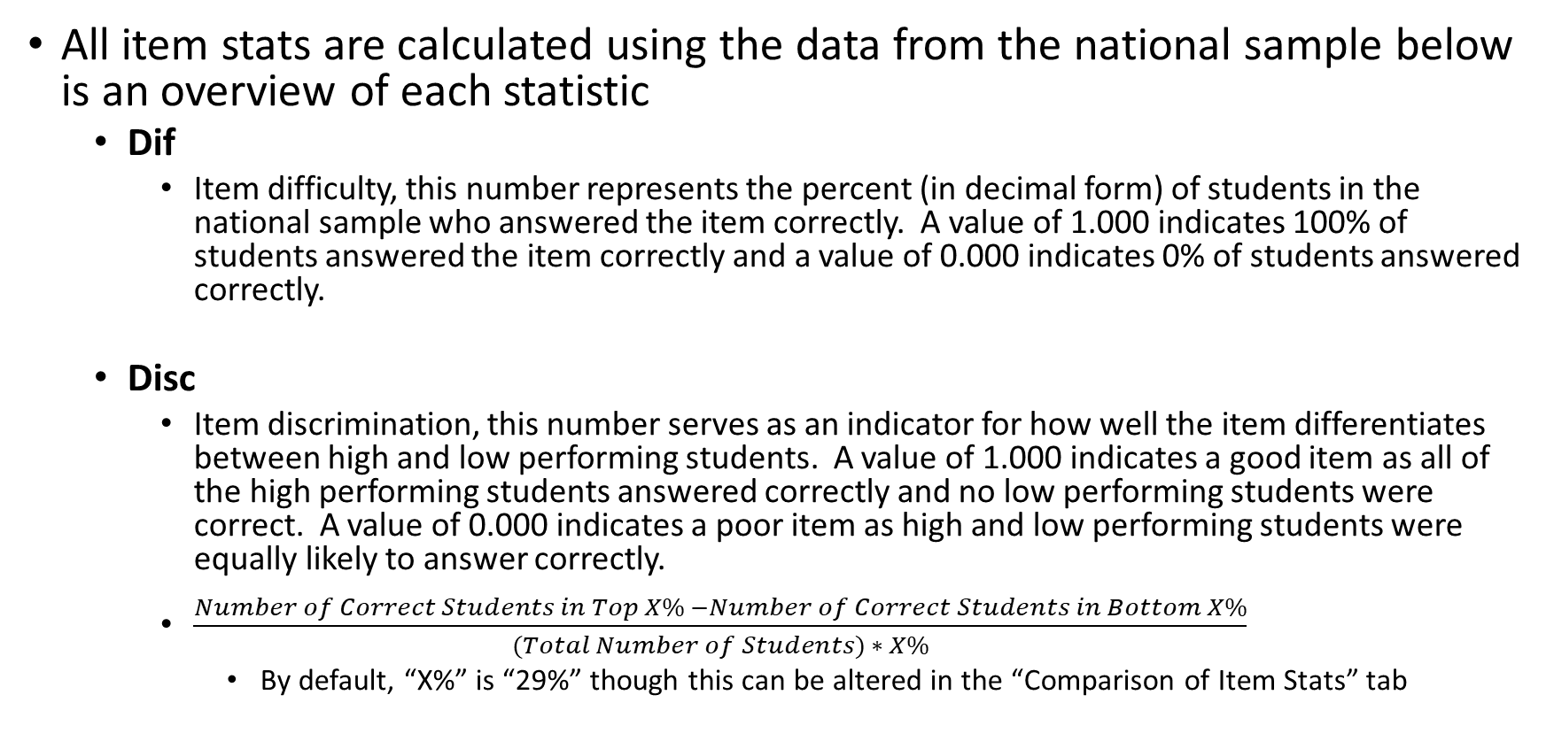
National Item Statistics
All item stats are calculated using the data from the national sample below is an overview of each statistic
  Dif
    Item difficulty, this number represents the percent (in decimal form) of students in the national sample who answered the item correctly. A value of 1.000 indicates 100% of students answered the item correctly and a value of 0.000 indicates 0% of students answered correctly.
  Disc
    Item discrimination, this number serves as an indicator for how well the item differentiates between high and low performing students. A value of 1.000 indicates a good item as all of the high performing students answered correctly and no low performing students were correct. A value of 0.000 indicates a poor item as high and low performing students were equally likely to answer correctly.
    $\frac{Number of Correct Students in Top X\% −Number of Correct Students in Bottom X\%}{(Total Number of Students) ∗ X\%}$
      By default, “X%” is “29%” though this can be altered in the “Comparison of Item Stats” tab

Slide 10
National Item Statistics
All item stats are calculated using the data from the national sample below is an overview of each statistic
  % 1st Wrong, % 2nd Wrong, % 3rd Wrong
    Incorrect response percentage, these values are the counterpart to item difficulty for the incorrect responses as they show the percentage of students selecting each incorrect response. To preserve exam security, the percent of letter responses is blinded but can be found using your exam key as follows.
  % Omit
    Missing response percentage, these values are the counterpart to item difficulty for the missing responses as they show the percentage of students who did not respond.
If A is the correct answer
  % 1st Wrong = %B
  % 2nd Wrong= %C
  % 3rd Wrong = %D
If B is the correct answer
  % 1st Wrong = %A
  % 2nd Wrong= %C
  % 3rd Wrong = %D
If C is the correct answer
  % 1st Wrong = %A
  % 2nd Wrong= %B
  % 3rd Wrong = %D
If D is the correct answer
  % 1st Wrong = %A
  % 2nd Wrong= %B
  % 3rd Wrong = %C

Slide 11
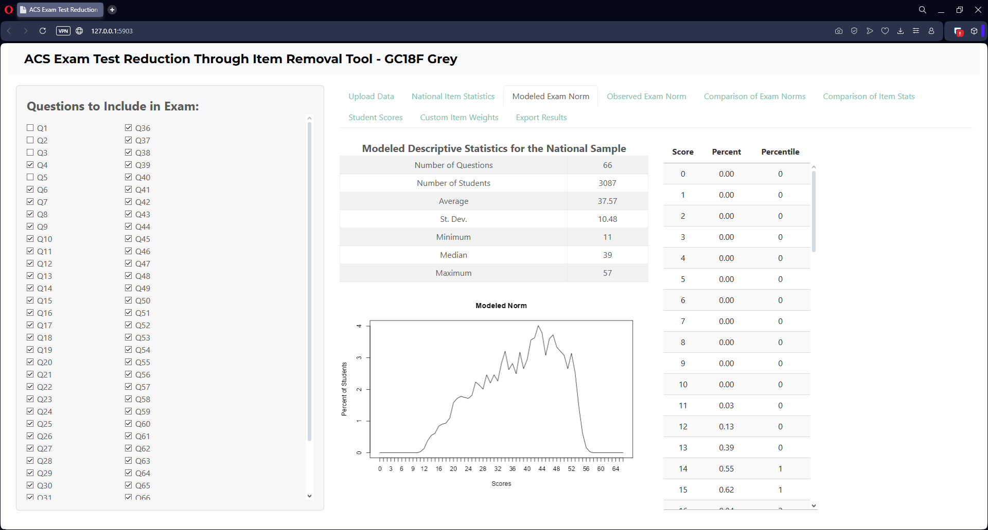
Modeled Exam Norm
Based on the questions you have selected; this tab provides an estimate of what the national norm would look like based on IRT modeling. Included are descriptive statistics, a norm plot, and the percent/percentile for each possible score.

Slide 12
Modeled Exam Norm
While an “Observed Exam Norm” is also provided, we recommend the usage of this “Modeled Exam Norm”. We recommend the use of these modeled norms over the “Observed Exam Norm” as these models utilize all national data (students and questions) where the “Observed Exam Norm” simply ignores data from the unselected items. Ongoing research at ACS Exams is what developed the precise modeling technique and has found this method to be highly accurate in norm prediction.

Slide 13
Modeled Exam Norm
Specific details for the precise models and methodology used to generate this data can be obtained by reaching out to David at schreurd@uwm.edu. To summarize, modeled norms are estimated the following way.
Automated assignment of partial credit using a Nested Logit Modeling of all items through nesting of a 2-PL and Nominal Response Model
Generalized Partial Credit Model of polytomous data to generate student ability estimates
2-PL IRT model to generate item parameters
Integration of 2-PL parameters and Generalized Partial Credit Model factor scores to produce probabilities for each student on each item
Sum of probabilities for each student across the selected items

Slide 14
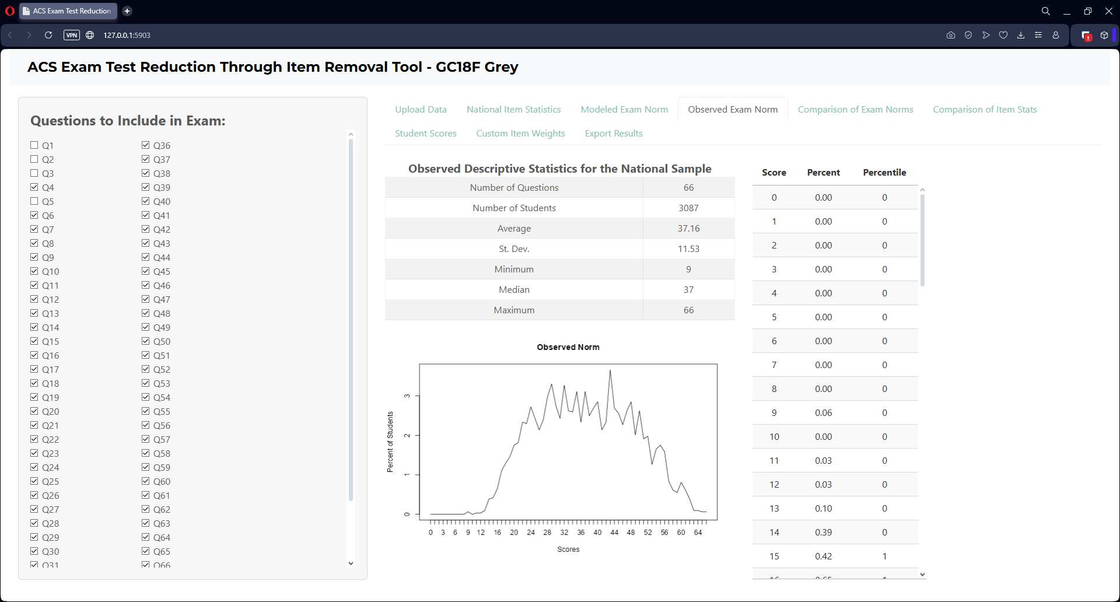
Observed Exam Norm
Based on the questions you have selected; this tab provides an estimate of what the national norm would look like by ignoring national data from unselected items. Included are descriptive statistics, a norm plot, and the percent/percentile for each possible score.
Further details and results from using this method can be found here:
  Reed, J. J., Raker, J. R., & Murphy, K. L. (2019). Evaluation of Subset Norm Stability in ACS General Chemistry Exams. Journal of Chemical Education, 96(10), 2132–2140. https://doi.org/10.1021/acs.jchemed.9b00125

Slide 15
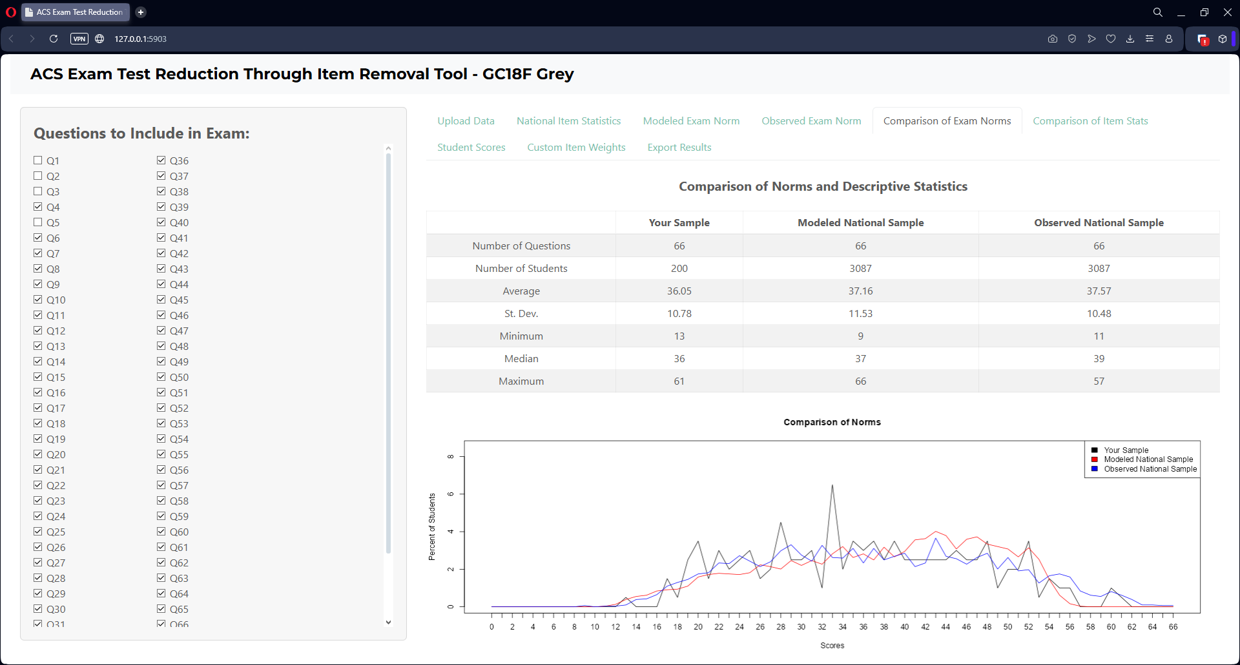
Comparison of Exam Norms
If you have uploaded your own data, this tab provides a comparison between the distribution of your students and the national students (based on both the modeled national sample and the observed national sample)

Slide 16
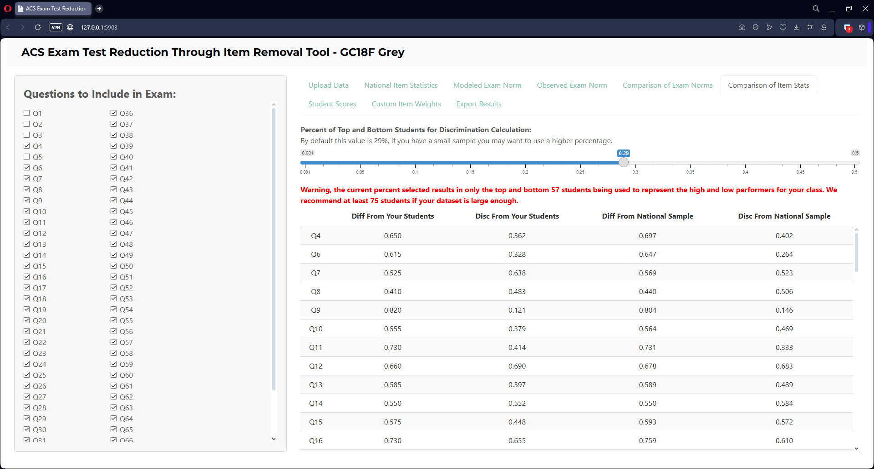
Comparison of Item Stats
If you have uploaded your own data, this tab compares the difficulty and discrimination for each selected question between your students and the national sample. You may also alter the percent of students used to represent the high and low performing students when calculating discrimination.

Slide 17
Comparison of Item Stats
If you have a small sample, or set the discrimination percentage slider too low, a warning will render that less than 75 students are being used to represent the low and high sample. In these cases, it may be wise to increase the percentage slider.

Slide 18
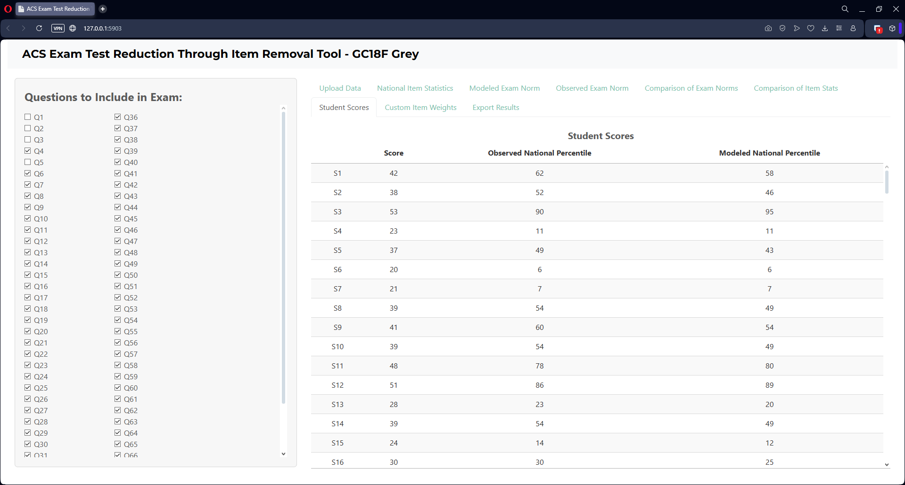
Student Scores
If you have uploaded your own data, this tab will render your students' scores for the selected items as well as their percentile ranking within the national sample. Both the observed and modeled exam percentile are provided.

Slide 19
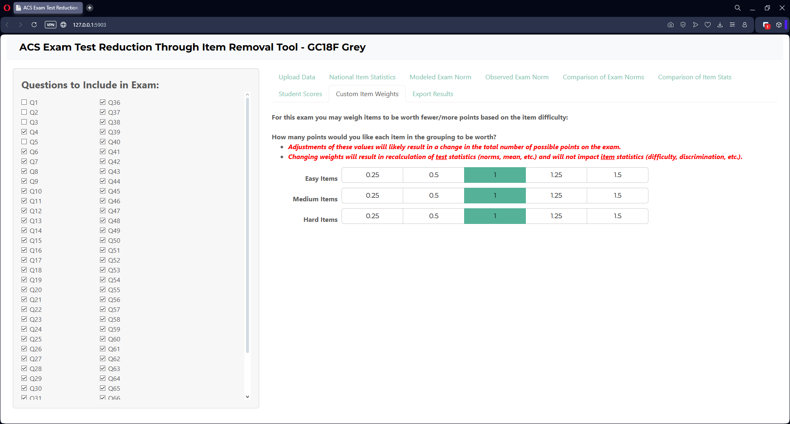
Custom Item Weights
This tab allows customization of the number of points (weight) assigned to subsets of items. By default, items can be assigned different weights based on item difficulty which can be a valuable tool for normalizing skewed score distributions. In selecting weights, all scores and test statistics
(“Modeled Exam Norm”,
“Observed Exam Norm”,
and “Comparison of Exam
Norms”) will be recalculated
for both your uploaded data
as well as the national data.

Slide 20
Custom Item Weights
Custom item weight subgroupings (Visual Spatial/Non-Visual Spatial; Algorithmic/Conceptual; Content Area; etc.) for specific exams can be requested by reaching out to us at kmurphy@uwm.edu.

Slide 21
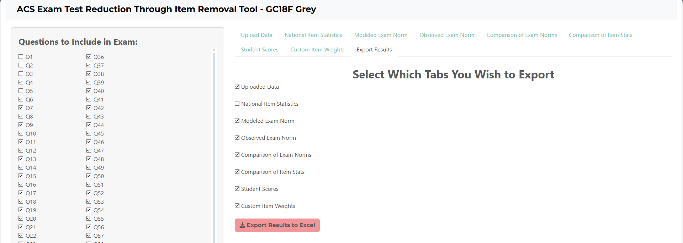
Export Results
Once you have finalized the questions you wish to include, results can be exported to excel. Each of the tabs in the web app can be selected for export. In addition, your uploaded data can also be redownloaded for future reference. A subset of the tabs we feel will be most useful will be selected by default, but you can add/remove tabs to your liking.

Slide 22
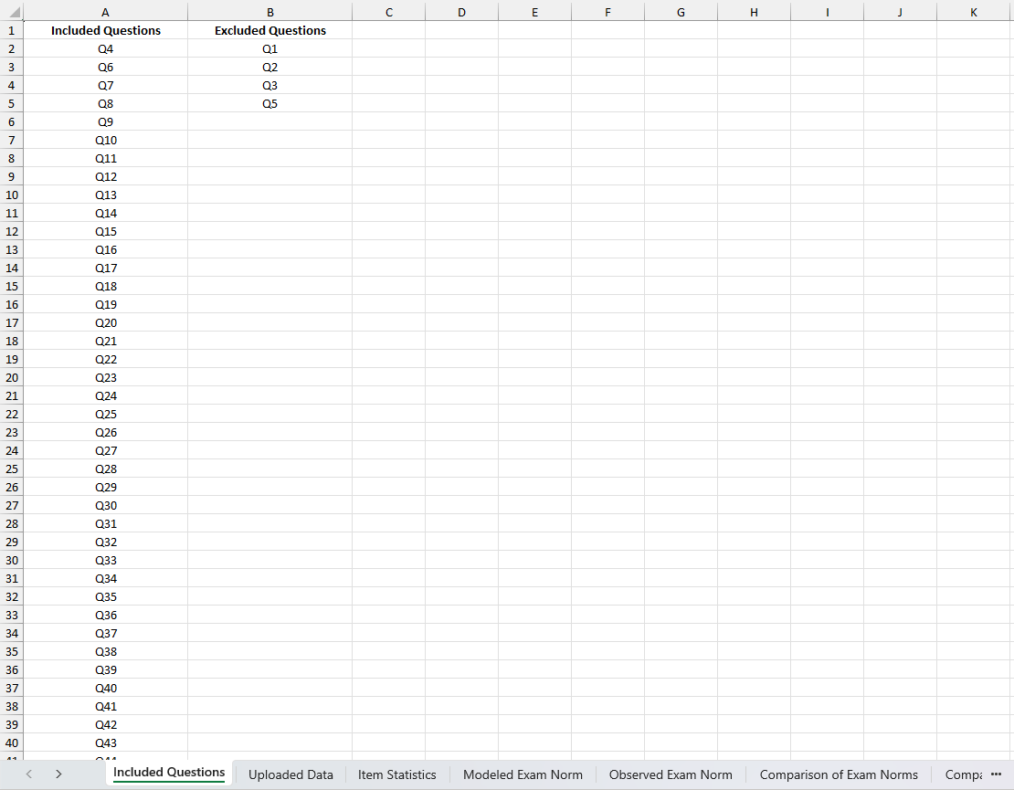
Excel Results
After you click the “Export Results to Excel” button, an excel document named “ACS Exam Report.xlsx” will be downloaded. The first tab will always include the questions you selected and unselected. The other tabs will be based on your selection in the “Export Results” tab in the web app.

